Slide 1
Mojaloop on Azure marketplace phase #2
PI-21 March 2023

Slide 2
Current Mojaloop deployment options Each option has purpose/strength/weakness
IaC
Comprehensive Mojaloop deployment aimed at giving users a starting point for production.
Highly automated (terraform, ansible)
Potentially on-prem
Currently still requires significant expertise to use
Cloud (VM) costs need to be managed
Manual using docs
gain a good understanding of the infrastructure
Instructions for Linux,Mac and Windows
Manual process (not easily repeatable)
Slow
No good for ci/cd etc
Azure Stack Hub
Similar end-state to Azure (native) but on Stack HUB (data residence)
Deploys to managed Kubernetes => easier management
Currently deploys Mojaloop 13.1
Cloud SLA costs need to be managed
Significantly less automated than Azure Native deployed from Marketplace
Mojaloop on Azure Marketplace
(Azure AKS native)
Sophisticated Mojaloop deployment aimed at giving users a starting point for production.
Highly automated ARM template
Extremely simple deployment
Deploys to managed Kubernetes => easier management
Currently deploys Mojaloop 13.1
Cloud SLA costs need to be managed
mini-loop
For demo/test/dev ci/cd POCs , training
Highly automated and simple to use
Cheap (laptops, small VMs etc) !
Quick
Tested on Ubuntu 20, 22
Not for production
Not secure

Slide 3
VM
OS
storage
Kubernetes control
Kubernetes nodes
Database
Encryption
Certs
key mgmt.
.more
Mojaloop in VMs
Cloud VM
Cloud VM
Today
Manual
Mini-loop
IaC
Cloud VM
Cloud VM
Cloud VM
Running
Mojaloop 14.1
Mojaloop in Managed Kubernetes
AKS Cluster
API Mgmt
Security
Lifecycle svcs
Deploy AKS cluster and MySQL cluster
Deploy from Azure Marketplace
Managed DB
Managed Secrets
Auto-scaling
Running
Mojaloop 13.1
2. Need to be able update running Mojaloop

Slide 4
Workstream Update
Workstream Name: | Azure (phase #2)
Roadmap Pillar: | 1 make adoption easier (and increase adoption/interest/participation )
Leader/cheer leader tech support | Jason Gregory Microsoft / Tom Daly Crosslake/Mojaloop
Objectives: | 1) Remove obstacles to deploying 2) grow participation in Mojaloop eco-system 3) partner to take advantage of Microsoft market presence [ help them to help our mission]
Progress Against Objectives: | Mojaloop on Azure Marketplace delivered in PI 20/21 Assessed work to upgrade to Mojaloop v15.x => not hard
Anticipated Progress by PI End: | Update Azure Marketplace to deploy Mojaloop v15. Add Azure deployment to Mojaloop getting started docs OpenSource existing Mojaloop work : helm charts / ARM templates etc Stretch : Simplify deployment on Azure Stack HUB
Roadblocks: | Just waiting on Jason to clear legal hurdles to open source the packaging work they did
Support Needed/Resource asks: | As above. Want to reconcile their packages with main Mojaloop repo (seems ok)

Slide 5
Rawanda SI Training – Azure
demonstrated deploying Mojaloop onto Azure native
Emphasis was on just how easy it is.
Pointed out where to save money (api mgmt SLA etc)
showed Mojaloop running on Azure stack hub
On stack hub in Liquid Telecom DC in Kigali !
Emphasis was on data soverignty and security also familiarity of Azure native and Azure stack hub.
Incredible the way Jason and Mark (Microsoft) made this happen : < 24 hrs earlier I was saying too hard, not enough time. BUT they got me everything needed, access, all sorts of help and in <6 hrs we got it done.

Slide 6

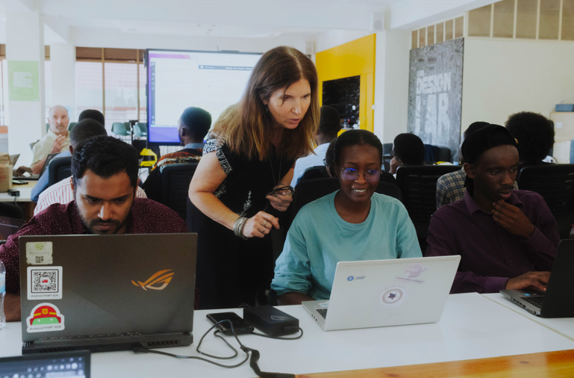

Pi-21 Workshop @ CCHub/Kilgli
CCHub Bootcamp Monday
Mojaloop Open Source Software for Fintech Companies and Open Source Developers
8 more people running Mojaloop
From scratch on free : Azure 30 day Trial Accounts

Slide 7
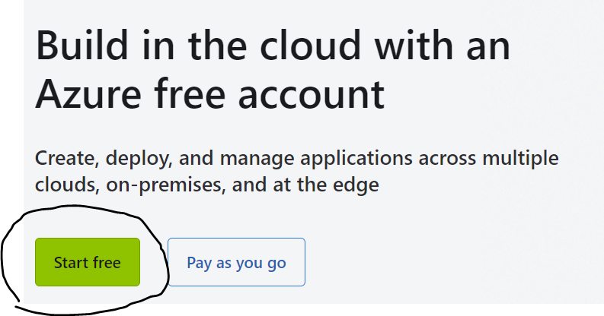
Azure Free Trial Setup
Create Azure Free Account
Use your personal email account (that is linked to MSFT) or create a new one.
https://azure.microsoft.com/en-us/free/
Enter your profile information
Need to verify identity via phone
Provide CC just for verification purposes

Slide 8
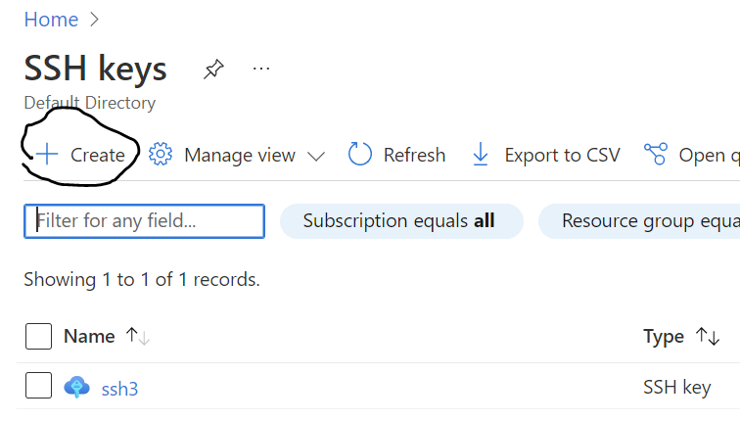
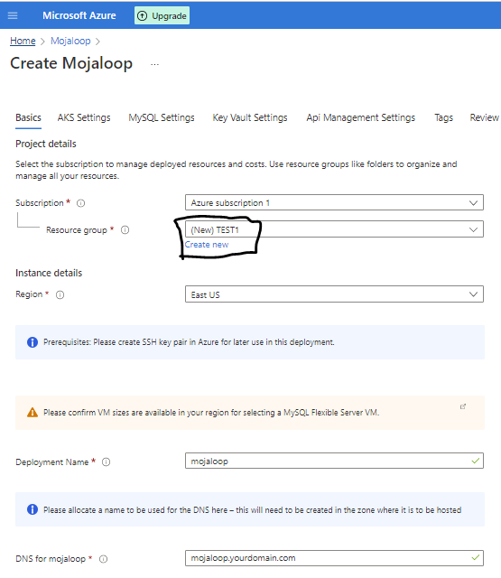
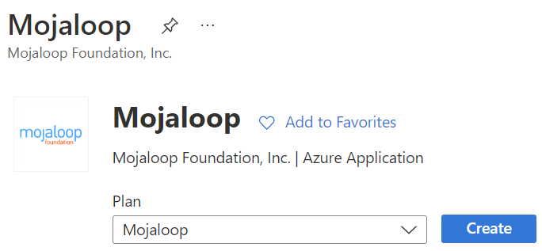
Azure/Mojaloop Setup
1) Create SSH Key
2) Marketplace:
3) Basic Information (1st tab)
New resource group

Slide 9
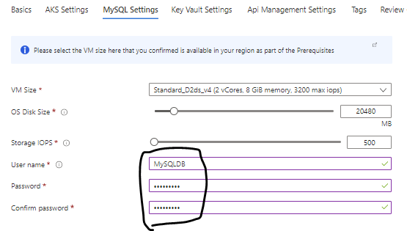
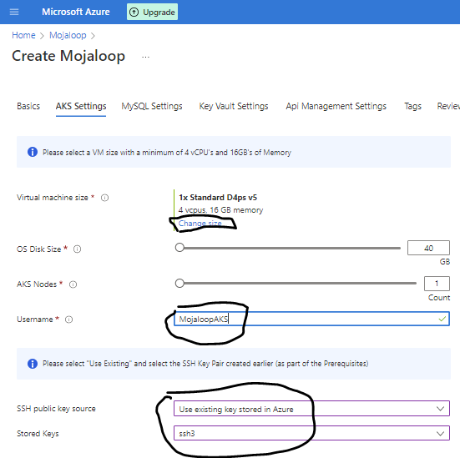
Azure Mojaloop Setup (#2)
4) AKS Settings
Change Size (4vCPUs, 16ram)
D-series v5 (pick cheapest)
Fillout AKS UserName
Use SSH key you created (#1)
5) MySql
Add Dbname & Password
6) KeyVault Settings
Default

Slide 10
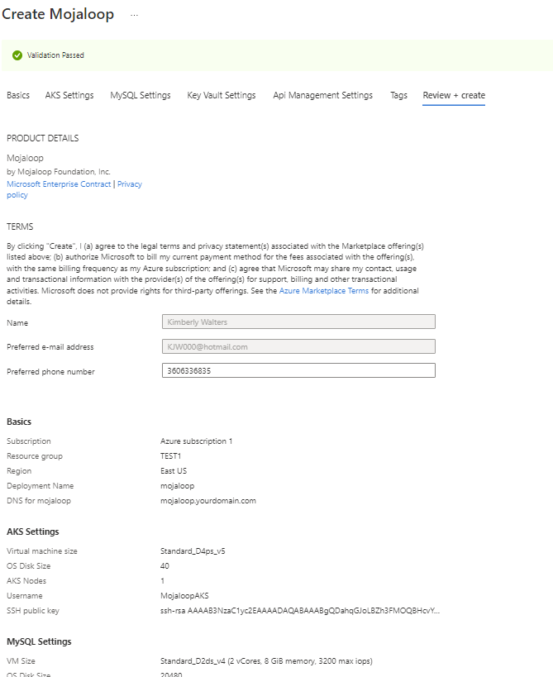
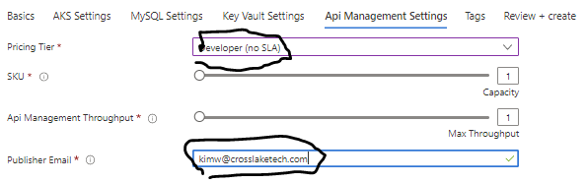
Azure Mojaloop Setup (#3)
7 )API Management Settings
Pricing Tier: Developer (NoSLA)
Your Email
8) Tags
Default
9) Review & Create
10) SUCCESS – DONE ☺

Slide 11
DEMO

